Slide 1
Smarter
Condominium Search
DSIF 2
Joseph Gan

Slide 2
Problem Statement
Foreign Expat who seek to rent a condominium unit in Singapore may not be aware of the market price.
We will develop a webapp to recommend users the suggested monthly rental price, similar units and similar neighbourhoods based on users’ preference.
MYHOME

Slide 3
TABLE OF CONTENTS
01
02
03
Predicting Monthly Rental
Neighbhourhood Clustering
Application Demonstration

Slide 4
Predicting Monthly Rental

Slide 5
Methodology
Data Acquisition
Data Cleaning
EDA
Univariate Distribution
Mean t-test
Multi-collinearity
Geospatial via Folium
Web scrapping of property website via Selenium
Outlier detection via QQplot
Missing data Imputation via Random Forest

Slide 6
Methodology
Feature Engineering
Algorithms
Final Model
Count Vectorizer
OneHotEncoding
Ordinal Encoding
Rare Label Encoding
Box-cox Transformation
Linear Regression
SVM Regressor
XGBoost Regressor
Feature Selection via RFE
Hyperparameter Tuning via Optuna
Out of Sample Evaluation
Diagnosis with Learning Curve

Slide 7
The Data
CASE STUDY
Data Source
01
www.99co.com
Size
02
7449 x 16
Features
03
monthly_price, bedrooms, bathroom, sqft, developer, district, built_year, facing, floor_level, furnishing, amenities etc..

Slide 8
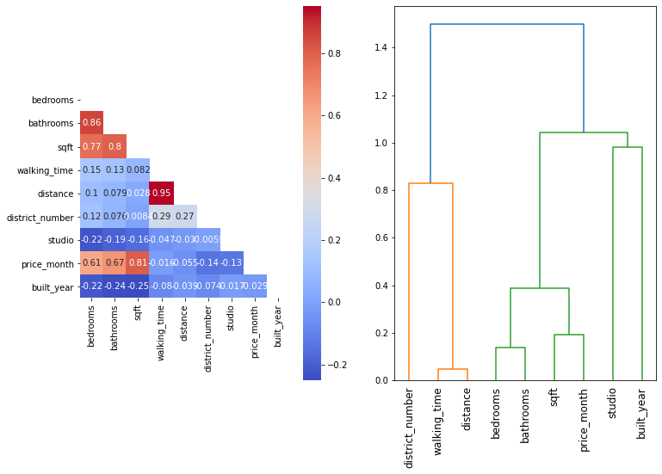
Key EDA: Dealing with Multicolinearity

Slide 9
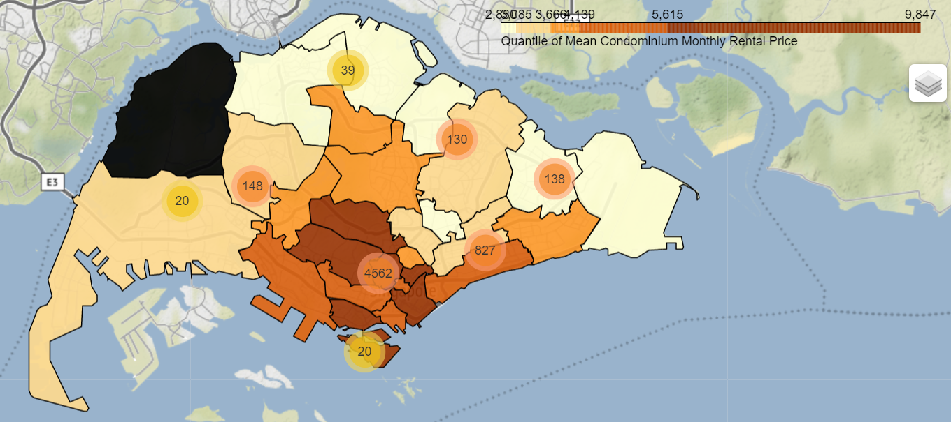
KEY EDA: Monthly Rental vs District

Slide 10
Algorithms Selection
5-Fold cross validation

Slide 11
Algorithms Selection
5-Fold cross validation
Baseline RMSE is $4444 by predicting monthly rental of $5800 (mean value of training sample) for each listing

Slide 12
Algorithms Selection
5-Fold cross validation
Validation Score | Mean RMSE | Std RMSE | mean adjusted_r2 | std adjusted_r2
Linear Regression | $3127 | $279 | 0.50 | 0.02
Baseline RMSE is $4444 by predicting monthly rental of $5800 (mean value of training sample) for each listing

Slide 13
Algorithms Selection
5-Fold cross validation
Validation Score | Mean RMSE | Std RMSE | mean adjusted_r2 | std adjusted_r2
Linear Regression | $3127 | $279 | 0.50 | 0.02
SVM Regressor | $2110 | $383 | 0.77 | 0.06
Baseline RMSE is $4444 by predicting monthly rental of $5800 (mean value of training sample) for each listing

Slide 14
Algorithms Selection
5-Fold cross validation
Validation Score | Mean RMSE | Std RMSE | mean adjusted_r2 | std adjusted_r2
Linear Regression | $3127 | $279 | 0.50 | 0.02
SVM Regressor | $2110 | $383 | 0.77 | 0.06
XGBoost Regressor | $1545 | $329 | 0.88 | 0.04
Baseline RMSE is $4444 by predicting monthly rental of $5800 (mean value of training sample) for each listing

Slide 15
Algorithms Selection
5-Fold cross validation
Validation Score | Mean RMSE | Std RMSE | mean adjusted_r2 | std adjusted_r2
Linear Regression | $3127 | $279 | 0.50 | 0.02
SVM Regressor | $2110 | $383 | 0.77 | 0.06
XGBoost Regressor | $1545 | $329 | 0.88 | 0.04
Baseline RMSE is $4444 by predicting monthly rental of $5800 (mean value of training sample) for each listing

Slide 16
Final Model (XGBoost)
01
Recursive Forward Elimination Feature Selection
12 features > 5 features (sqft, built_year, walking_time, district_number, mrt)

Slide 17
Final Model (XGBoost)
01
Recursive Forward Elimination Feature Selection
12 features > 5 features (sqft, built_year, walking_time, district_number, mrt)
Hyperparameter Tuning
02
Validation RMSE
$1545 --> $1478

Slide 18
Final Model (XGBoost)
01
Recursive Forward Elimination Feature Selection
12 features > 5 features (sqft, built_year, walking_time, district_number, mrt)
Hyperparameter Tuning
02
Validation RMSE
$1545 --> $1478
 | RMSE | Adjusted_R2
Training | $761 | 0.97
Validation | $1478 | 0.88
Test | $1298 | 0.91
Final Model Evaluation
03

Slide 19
Final Model (XGBoost)
01
Recursive Forward Elimination Feature Selection
12 features > 5 features (sqft, built_year, walking_time, district_number, mrt)
Why Test score better than validation?
Hyperparameter Tuning
02
Validation RMSE
$1545 --> $1478
 | RMSE | Adjusted_R2
Training | $761 | 0.97
Validation | $1478 | 0.88
Test | $1298 | 0.91
Final Model Evaluation
03

Slide 20
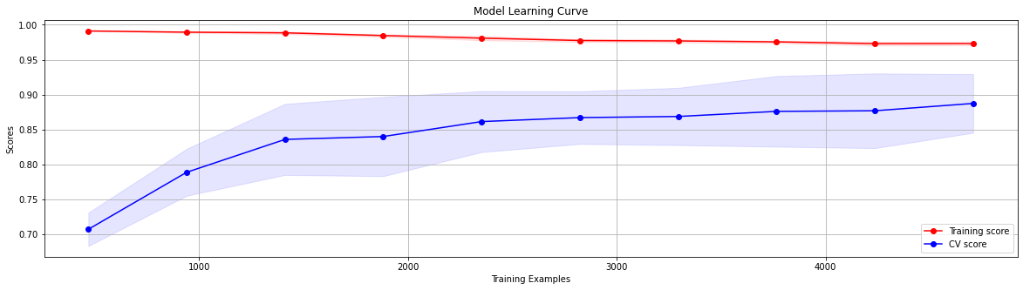
KEY INSIGHTS: Learning Curve

Slide 21
KEY INSIGHTS: Learning Curve
Score still showing increasing trend
as training sample increase

Slide 22
KEY INSIGHTS: Learning Curve
Score still showing increasing trend
as training sample increase
Model with Validation score (0.88) is trained on ~ 4600 sample due to 5-fold cv

Slide 23
KEY INSIGHTS: Learning Curve
Score still showing increasing trend
as training sample increase
Model with Validation score (0.88) is trained on ~ 4600 sample due to 5-fold cv
Model with test score(0.90) is trained on 6000 sample

Slide 24
KEY INSIGHTS: Learning Curve
Score still showing increasing trend
as training sample increase
Conclusion:
Model performance can still be improved by additional training data.
Model with Validation score (0.88) is trained on ~ 4600 sample due to 5-fold cv
Model with test score(0.90) is trained on 6000 sample

Slide 25
Neighbourhood Clustering

Slide 26
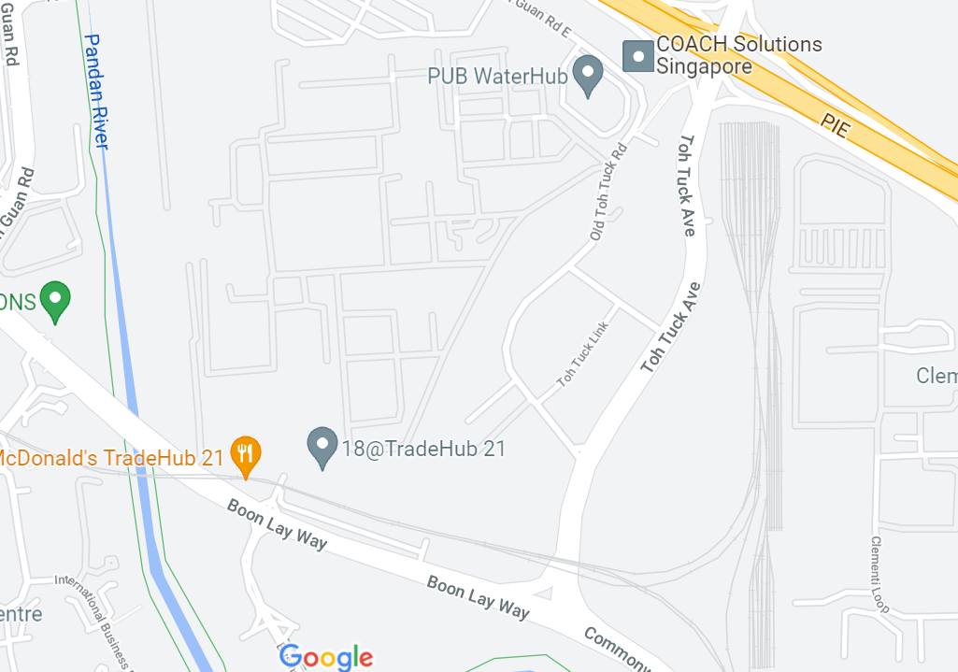
The Data
Arts & Entertainment
Nightlife
Spot
500m
Food
Outdoors & Recreation
Shop & Service

Slide 27
Methodology
Data Acquisition
Dimension Reduction
Clustering of Neighbourhood
Neighbourhood information via Foursquare API
UMAP
HDBScan

Slide 28
Methodology
Data Acquisition
Dimension Reduction
Clustering of Neighbourhood
Neighbourhood information via Foursquare API
UMAP
HDBScan

Slide 29
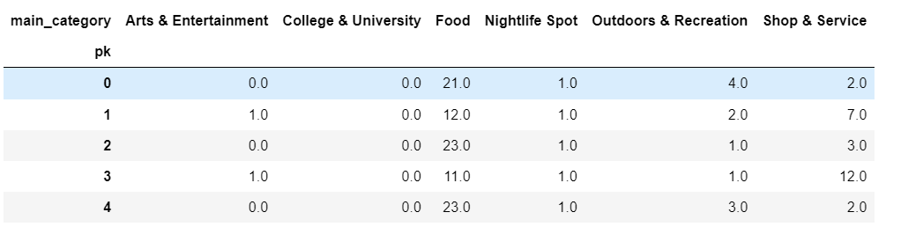
Snippet of Dataset

Slide 30
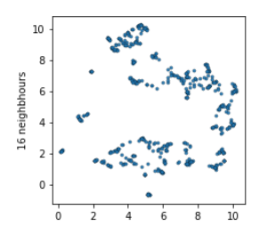
Dimension Reduction: UMAP

Slide 31
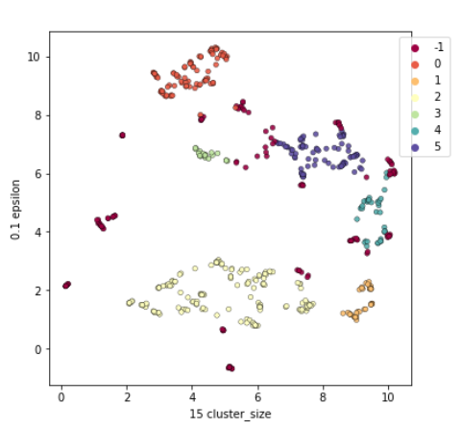
Clustering: HDBscan
6 clusters found by HDBscan

Slide 32
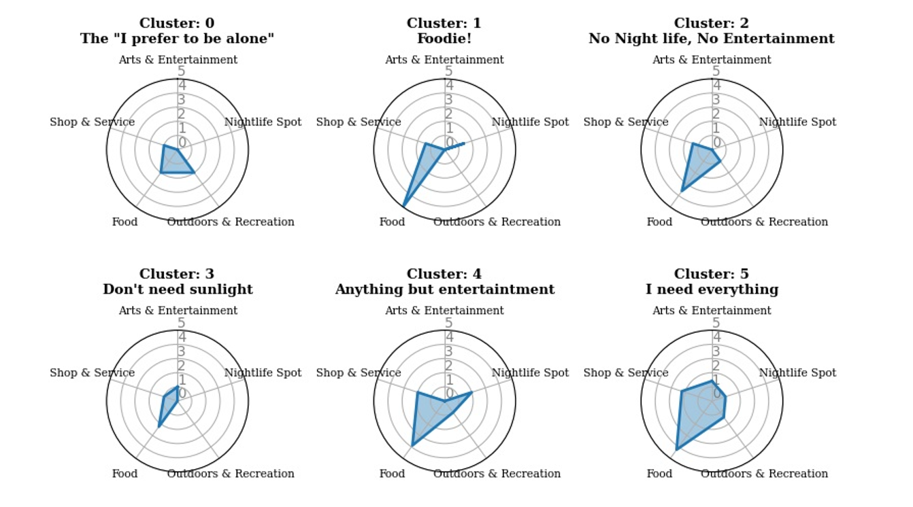
Cluster Intepretation

Slide 33
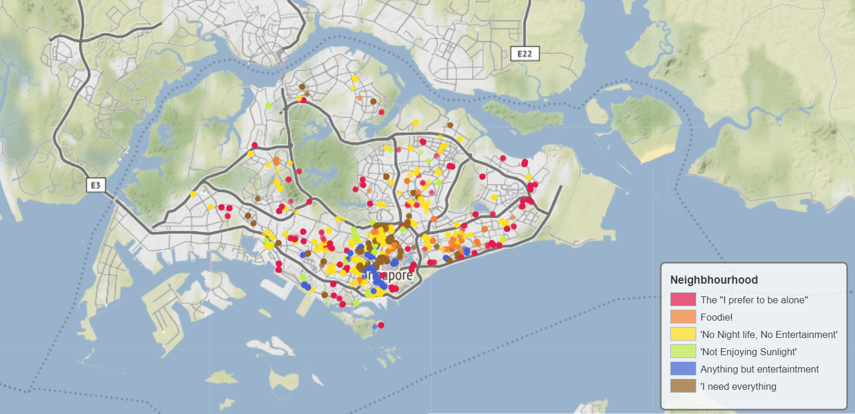
Cluster Visualization

Slide 34
Web Application

Slide 35

Deployment
https://smartercondosearch.herokuapp.com/

Slide 36
THANKS

Slide 37
APPENDIX

Slide 38
Data Cleaning

Slide 39
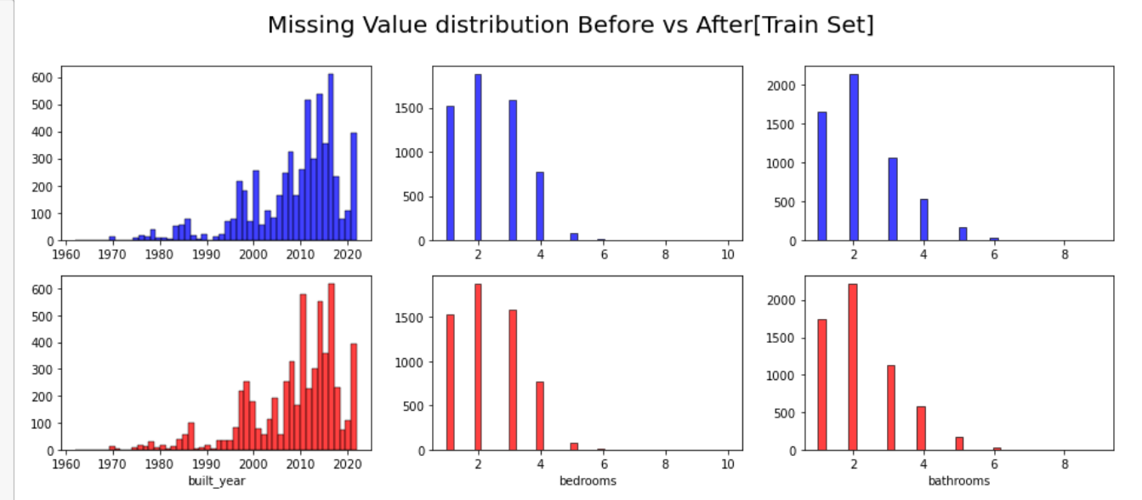
Imputation with Random Forest
Important that imputation does not alter our data distribution.

Slide 40
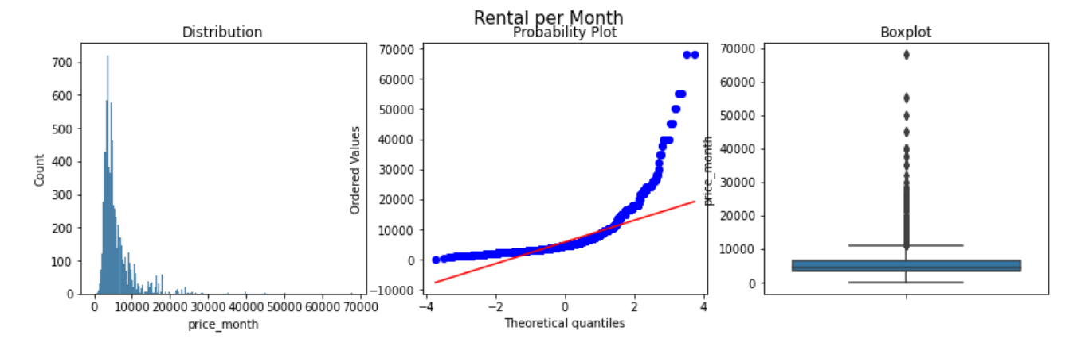
KEY INSIGHTS: Detecting Outliers

Slide 41
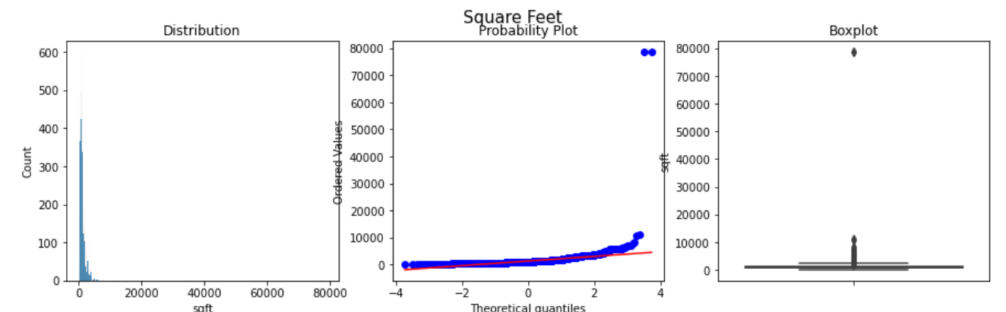
Detecting Outliers

Slide 42
EDA

Slide 43
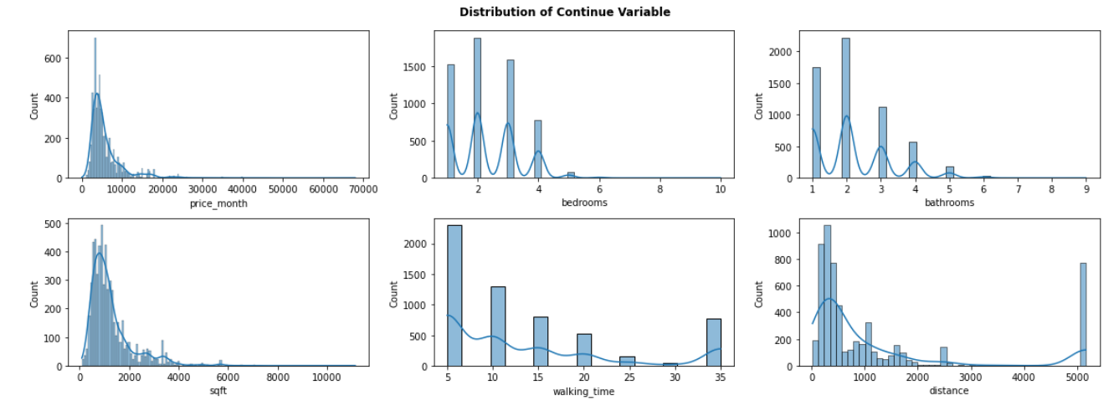
Univariate Analysis

Slide 44
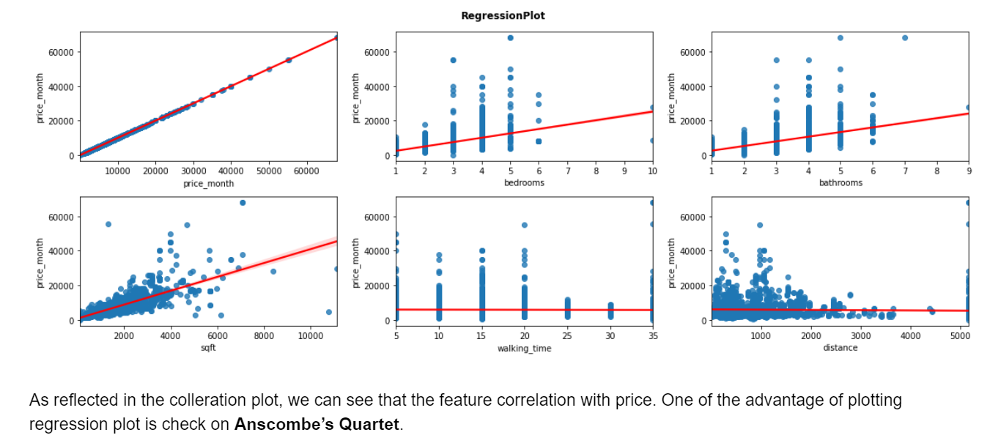
Understanding Correlation between Feature and Target

Slide 45
Dealing with Multicolinearity

Slide 46
Neighbourhood Clustering

Slide 47
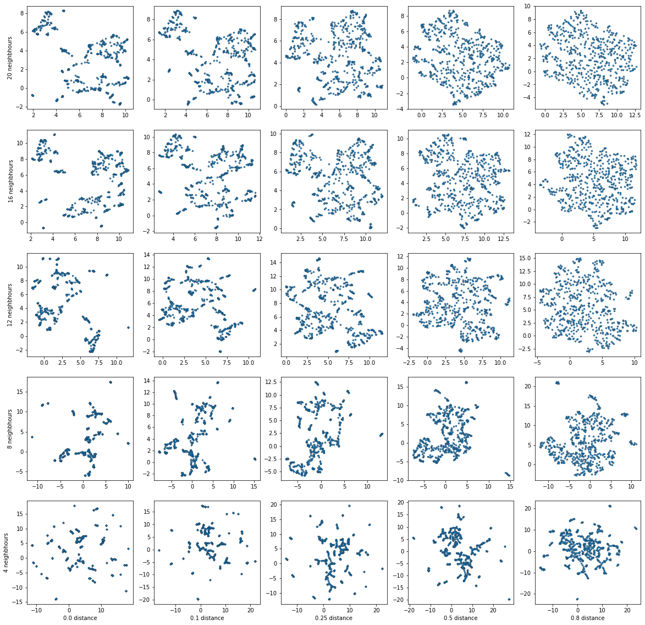
UMAP Hyperparameter Selection
Selected parameter
Increasing neighbours
Increasing minimum distance

Slide 48
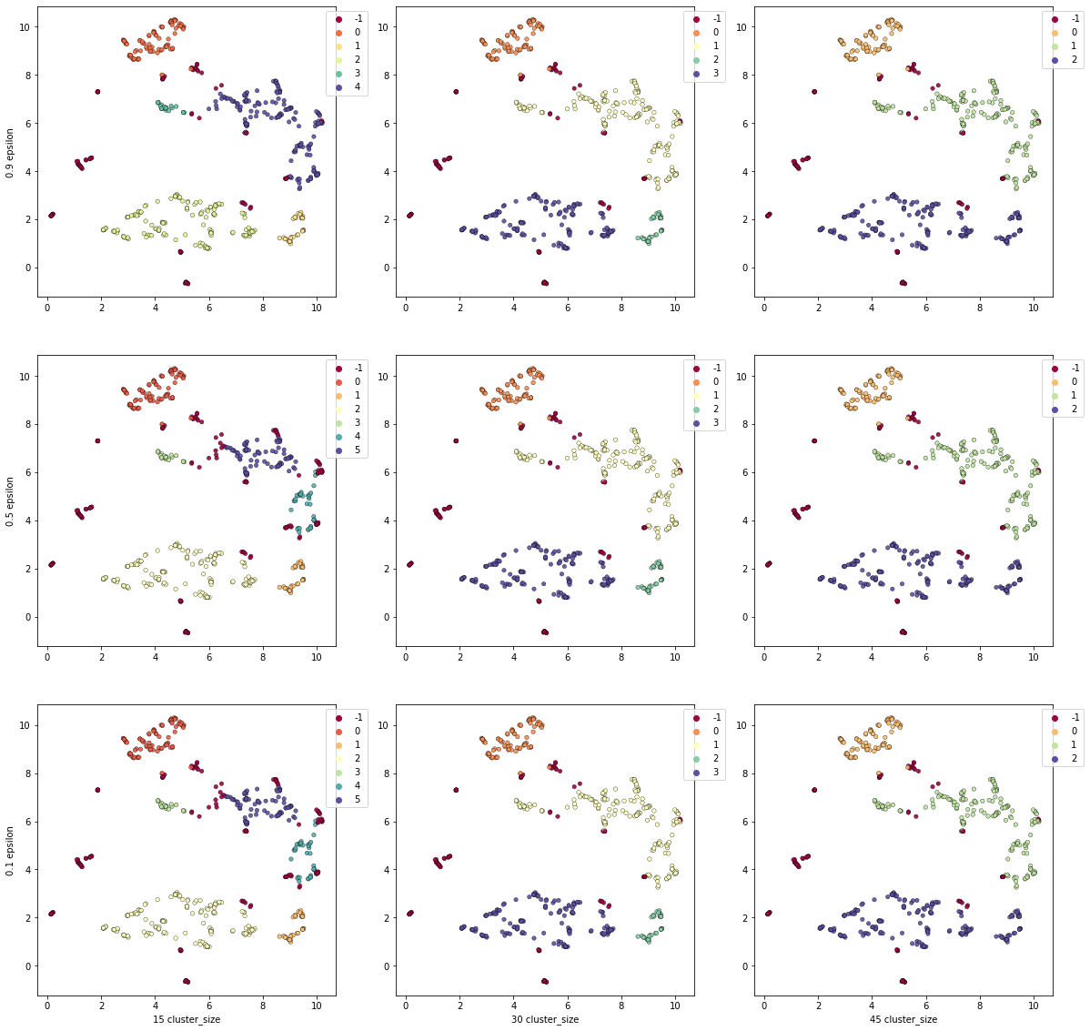
HDBscan Hyperparameter Selection
Selected clusters
Increasing epsilon
Cluster size

Slide 49
Recommender

Slide 50
Methodology
Feature Engineering
Model
Deployment
Feature Importance weightage
KNeighbours
Flask & Heroku

